Slide 1
SWAMI VIVEKANAND COLLEGE OF ENGINEERING, INDORE
COMPUTER SCIENCE AND ENGINEERING DEPARTMENT
SESSION : JAN- MAY 2018
{Online Gift Portal}
Guided By:
Mr. Ambrish Srivastav
Assistant Professor
Presented By:
Ruqaiya Arif
0822CS151088

Slide 2


Slide 3
Table of Content
Abstract
Introduction
Objective
Architectural Diagrams
Use Case Diagrams
Sequence Diagrams
Class Diagram
E-R Diagram
Wireframe-Homepage
Software and Hardware Requirement
Testing
Future Work
Conclusion
References

Slide 4
Abstract
Giftofakind.com is a complete portal to shop gifts worldwide. This portal is basically designed for small and medium businesses who don’t have online business. The Giftofakind.com has been developed to grow online businesses larger and faster. The Giftofakind.com contains a catalog for the user, for which user has to log in to Welcome page. Authenticity for every user will be maintained from the database. The portal has a registration screen, products order, catalog information, terms and condition which is printable and contact information of the supplier. This portal provides an interface for the medium scale business which are not known to the end user. It also provide recommendations for the related gifts to which user has searched.

Slide 5
Introduction
E-commerce businesses are fast growing and accepted business paradigm.
The objective is to create a gift store through which user can buy products such as anniversary gifts, birthday cakes etc. from their comfort through Internet. The Giftofakind.com is a virtual store from where user can choose gifts according to their interest, recipient, occasion, relationship, anniversary or birthday. The customer can add products to a virtual shopping cart and later go for payments where more information will be needed to complete the transaction like shipping address and billing address.
There will be payment option from credit card. Fairly, it requires handling and management of data involved in the process.
Target group of customers are those who live far away from their family, friends and relatives, to whom customer wants to send gifts. However, limit will be set to send gifts per day by a customer to different locations.
The purpose of the topic is to connect people via Internet through gifts.

Slide 6
Objective
The objective is to provide a virtual store from where a person can send gifts from anywhere, at anytime.
It enables purchasing from social media accounts.

Slide 7
Architectural Diagrams

Slide 8
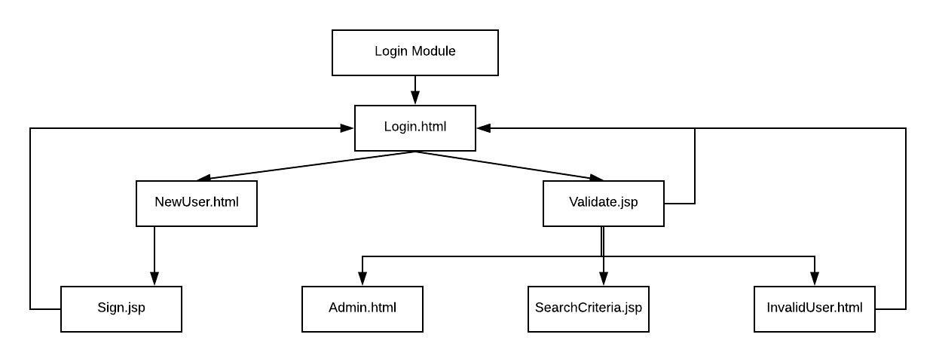
Login Module

Slide 9
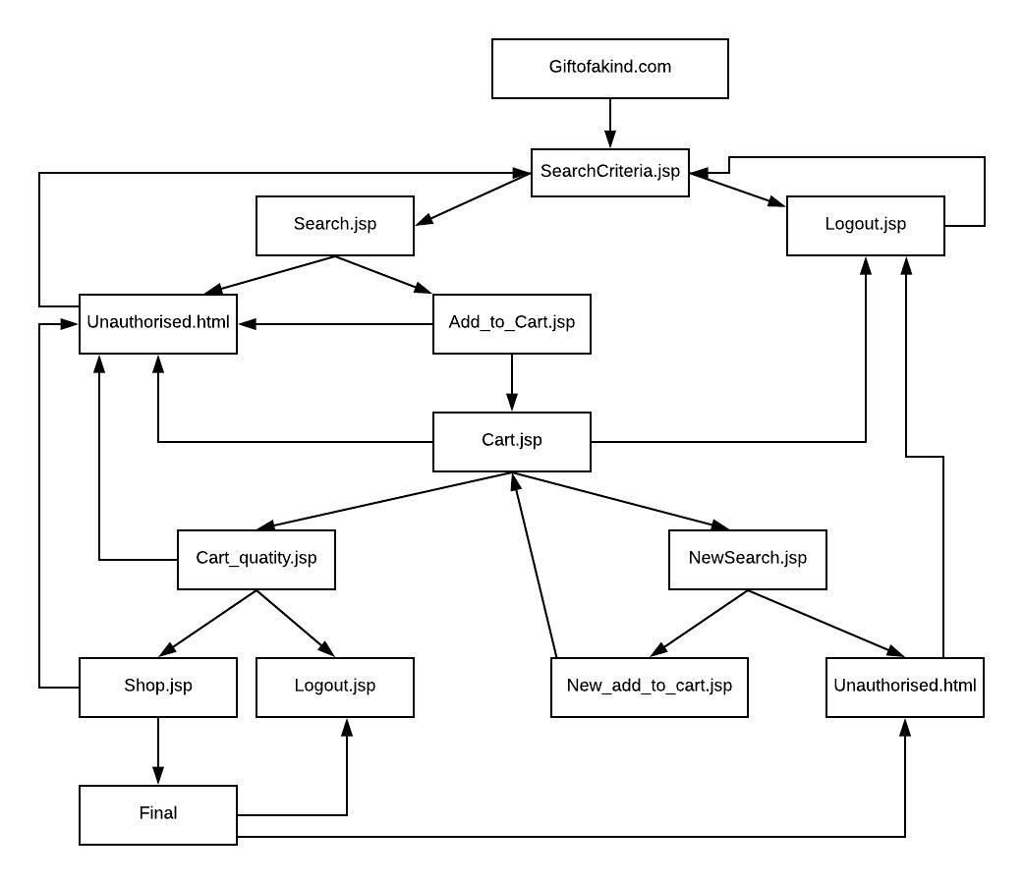
Shopping Module

Slide 10
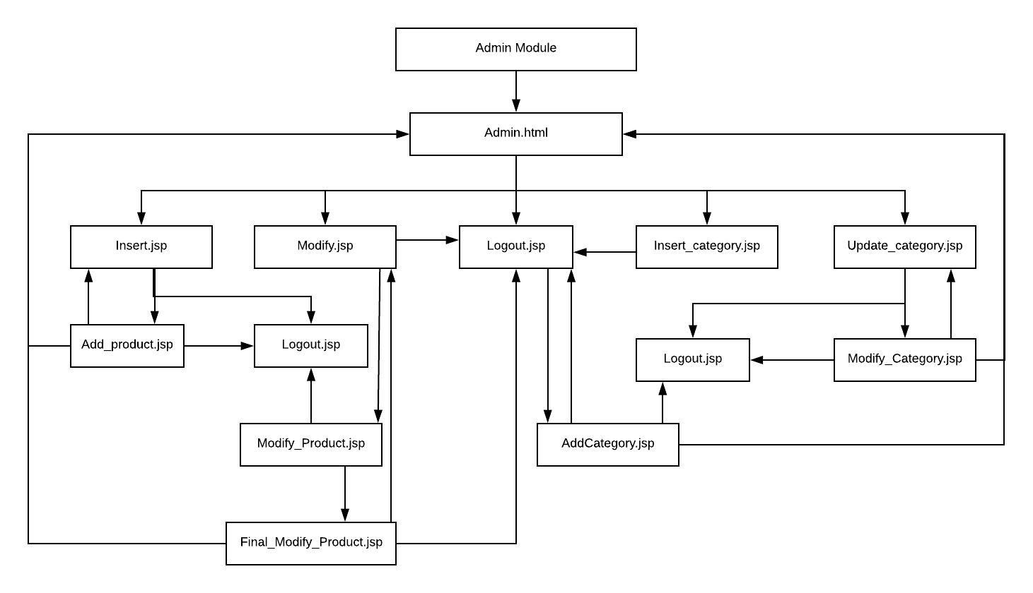
Admin Module

Slide 11
Use Case Diagrams

Slide 12
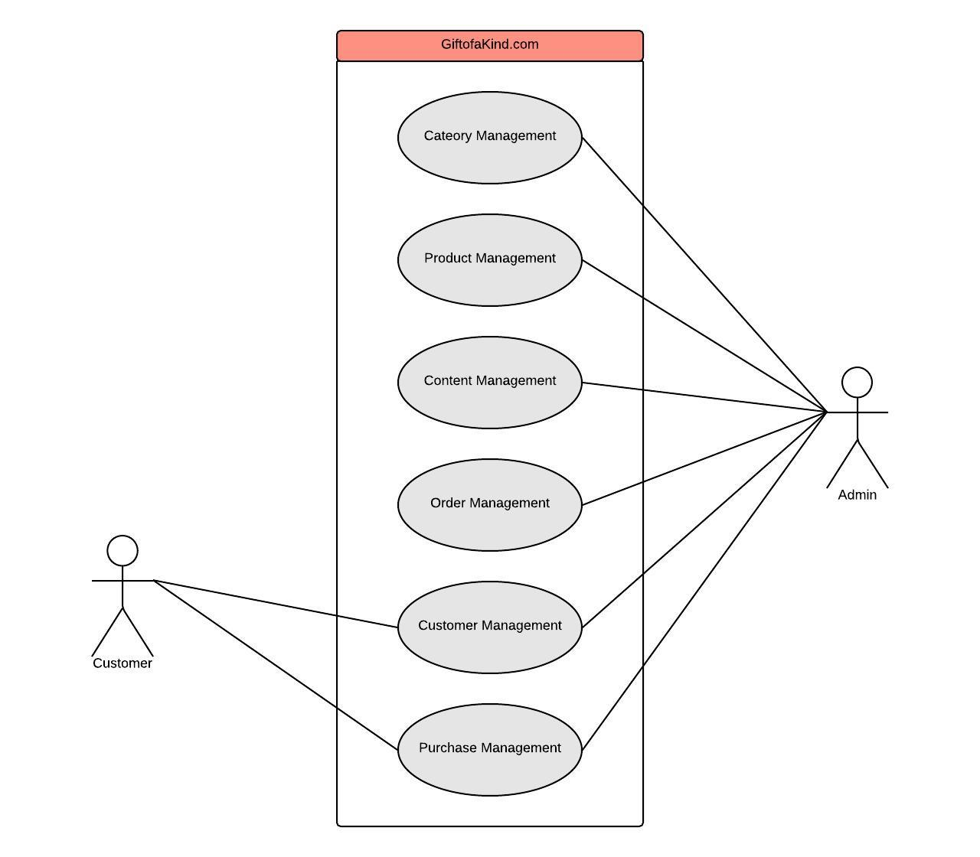
Portal Use case Diagram

Slide 13
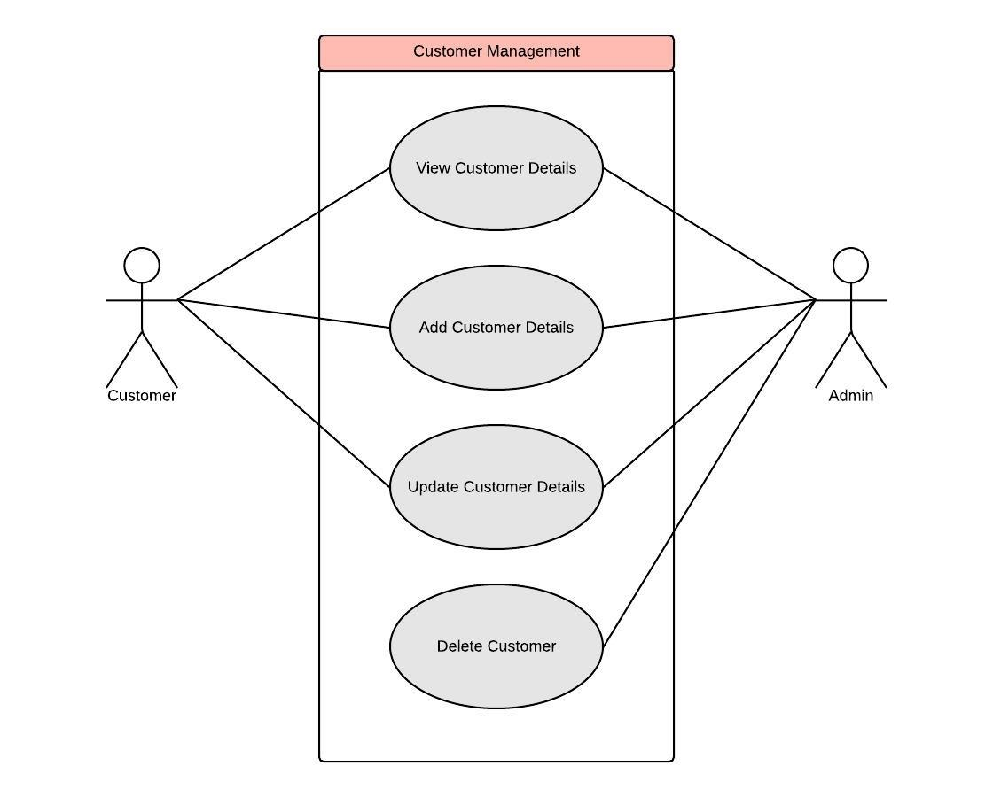
Customer Management

Slide 14
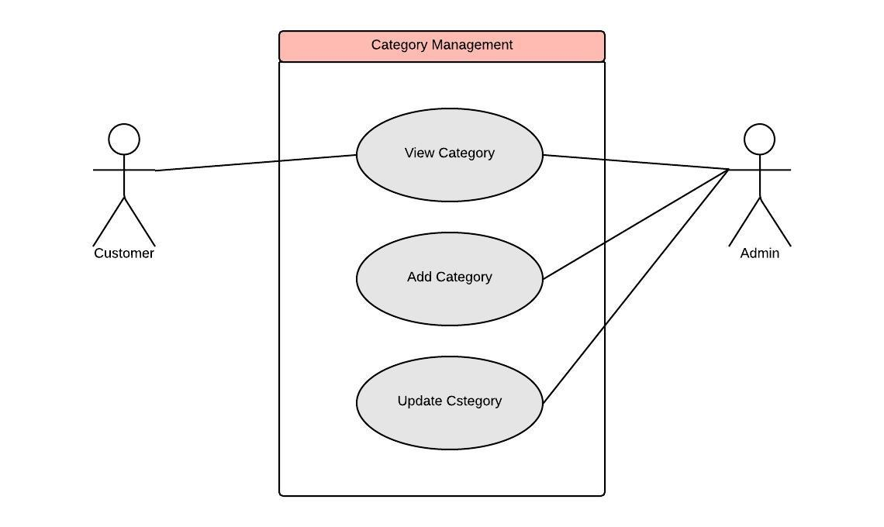
Category Management

Slide 15
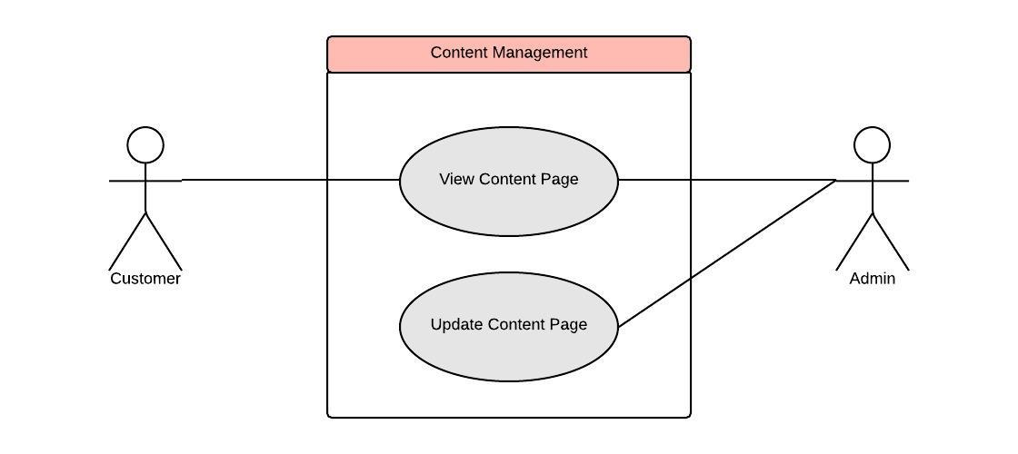
Content Management

Slide 16
Sequence Diagrams

Slide 17
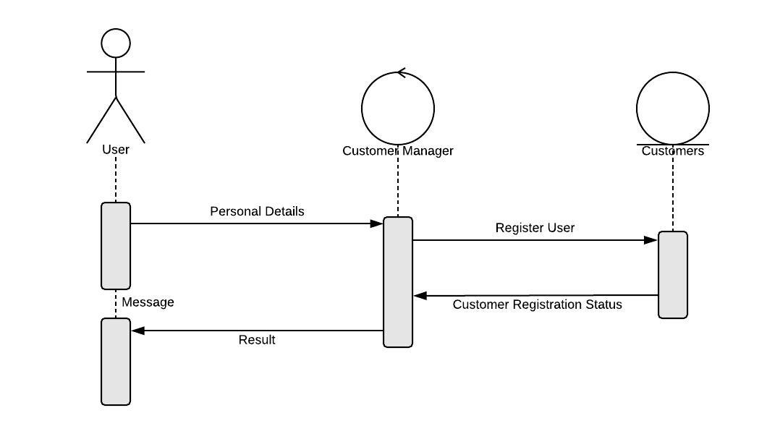
User Registration Module

Slide 18
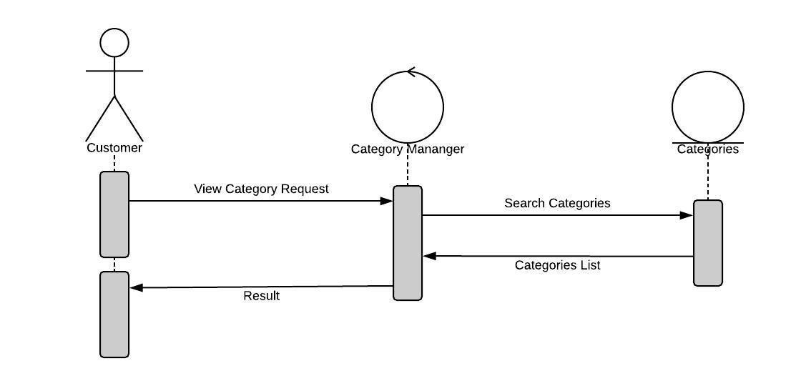
Searching Categories

Slide 19
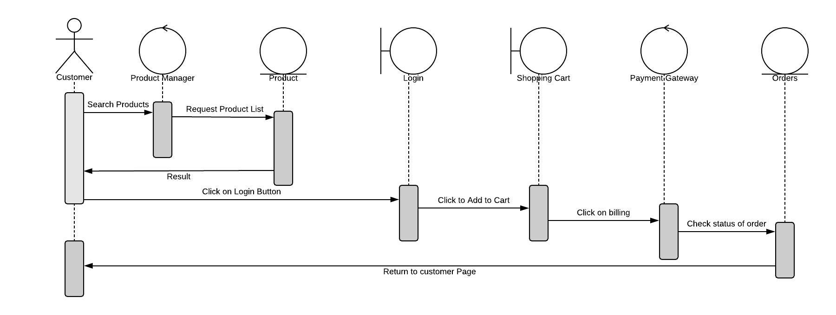
Product Purchase process

Slide 20
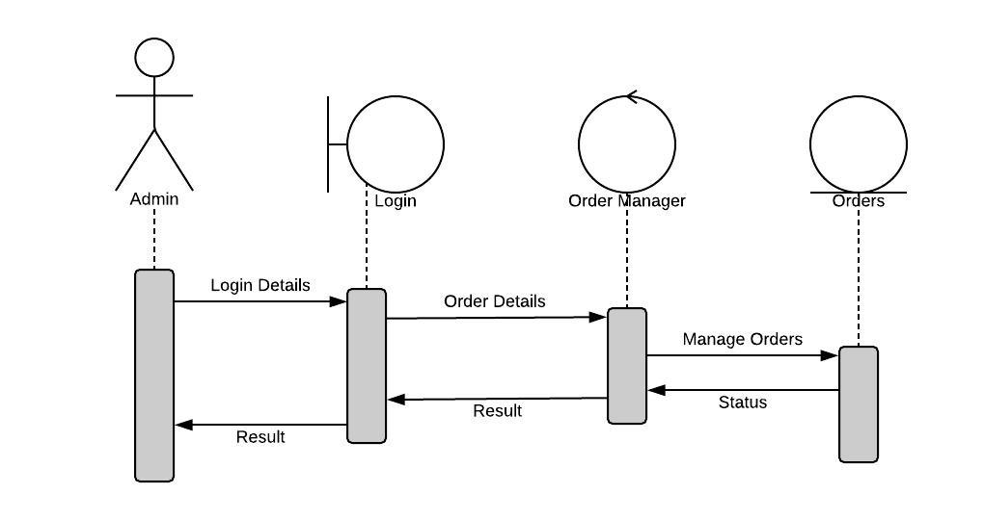
Order Management

Slide 21
E-R Diagram

Slide 22
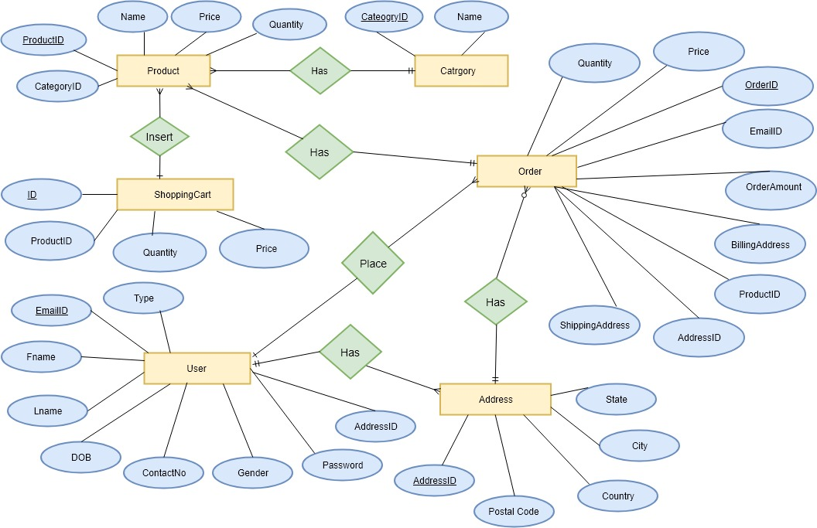

Slide 23
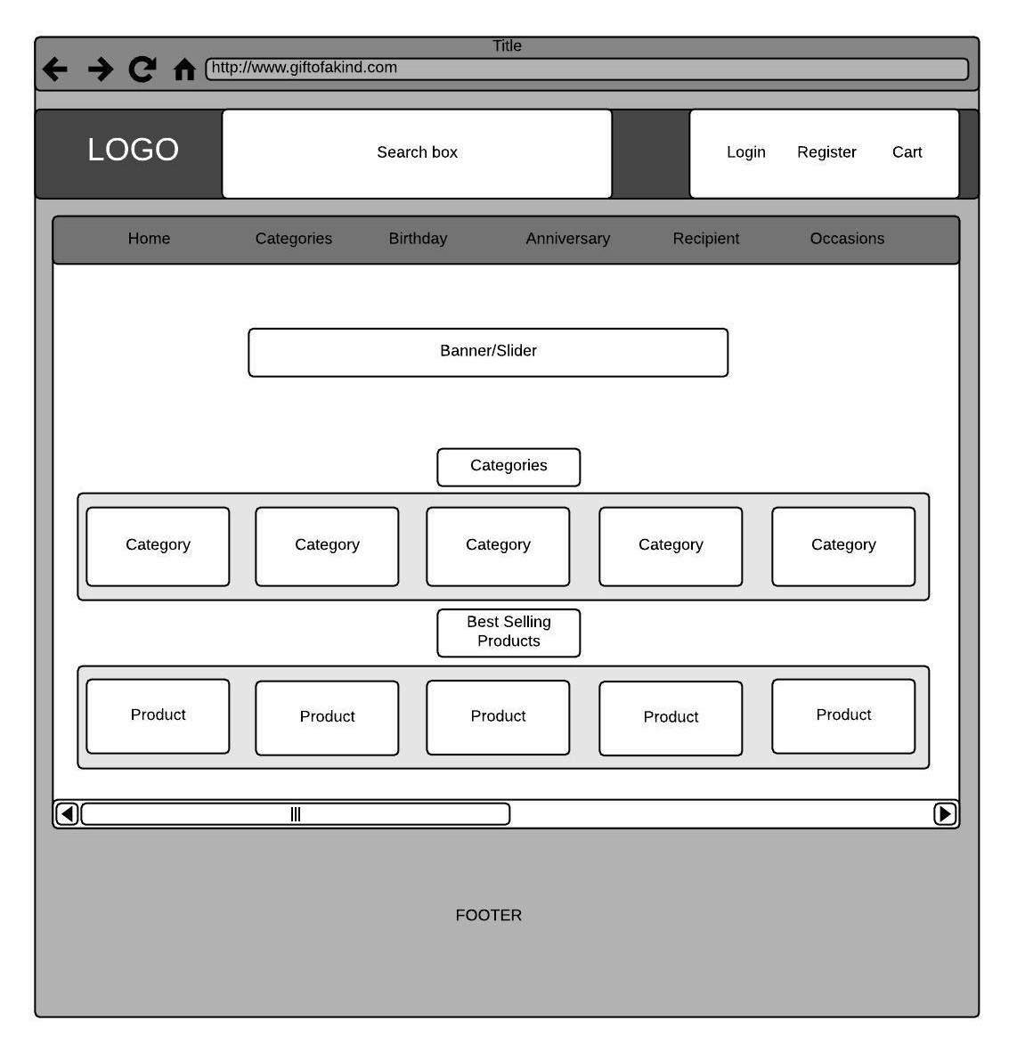
Wireframe Homepage

Slide 24
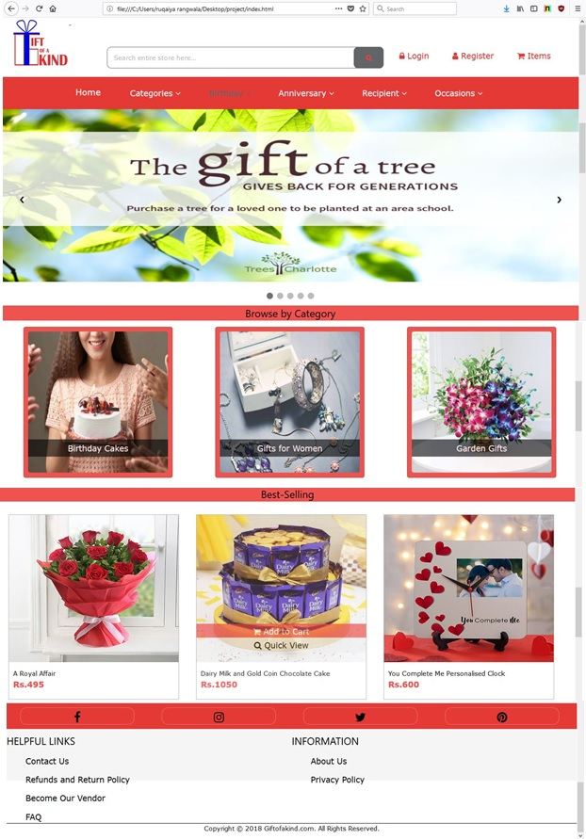

Slide 25
Software and Hardware requirement
Hardware requirements:
PIV 2.8 GHz Processor and Above
RAM 512MB and Above
HDD 20 GB Hard Disk Space and Above
Software requirements:
Windows OS (XP/2000 or above).
Sublime Text Editor.
NetBeans IDE 6.0 or above.
JDK version 6.0 or above.
Web server to execute website.
Any Web browser for testing.

Slide 26
Conclusion
In this project, the user is provided with an e-commerce web site that can be used to buy Products online. To implement this as a web application we have used Java Technologies for backend and html, css and Javascript for front-end.
For the client browser to connect we used Apache Tomcat as web server and used JDBC for database connectivity.
A good shopping cart design must be accompanied with user-friendly shopping cart application logic. It should be convenient for the customer to view the contents of their cart and to be able to remove or add items to their cart. The application described in this project provides a number of features that are designed to make the customer more comfortable.

Slide 27

References
http://www.igp.com.
http://www.giftscart.com
http://www.fernsnpetals.com
http://www.archiesonline.com.

Slide 28
Thank You

